Slide 1
Sales Analysis Power BI Mini Project
Interactive Sales Dashboard
Data Cleaning | Data Modelling | DAX | Data Visualization
Tools Used: Microsoft Power BI, Excel, PostgreSQL
Presented by: K Sravanti

Slide 2
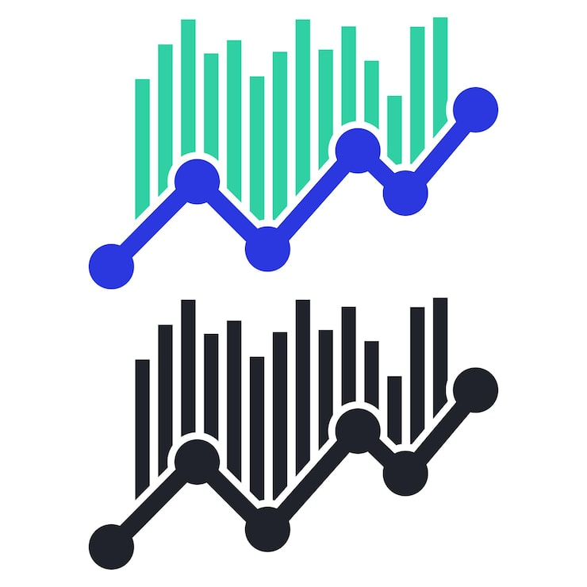
Business Problem and Project Overview
Worked on a retail sales dataset containing information about customers, employees, products and sales.
Identified data quality issues such as duplicate records, inconsistent formatting and missing values.
Developed an interactive Power BI dashboard to analyse sales performance.
Connected Excel-cleaned data and PostgreSQL tables to Power BI.
Project Outcome: Created a four-page interactive sales dashboard for business analysis.

Slide 3
Work Completed in the Project
Data Cleaning: Cleaned and validated five datasets using Excel and Power Query.
Database Integration: Created a PostgreSQL database and imported Orders and Order Items.
Data Modelling: Created table relationships and a Calendar table in Power BI.
DAX Calculations: Created measures for revenue, orders, quantity and time-based analysis.
Dashboard Development: Built four interactive report pages.
Security Testing: Created and tested the North Manager RLS role.

Slide 4
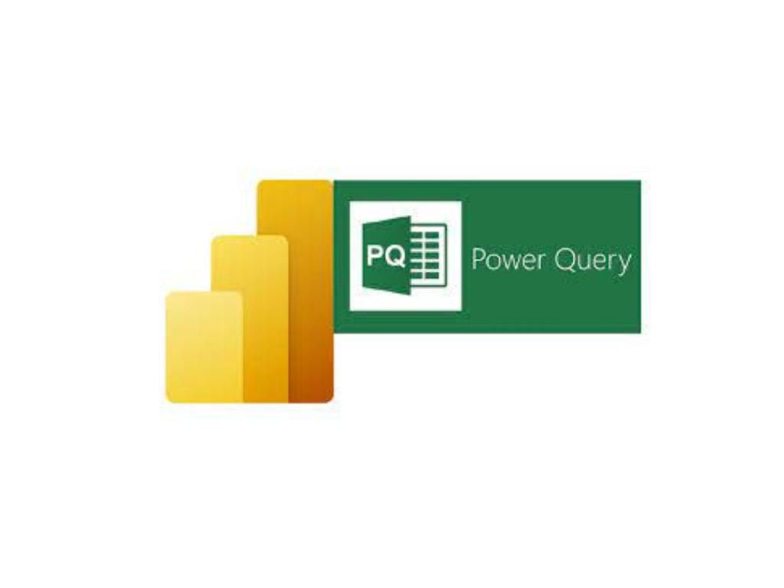
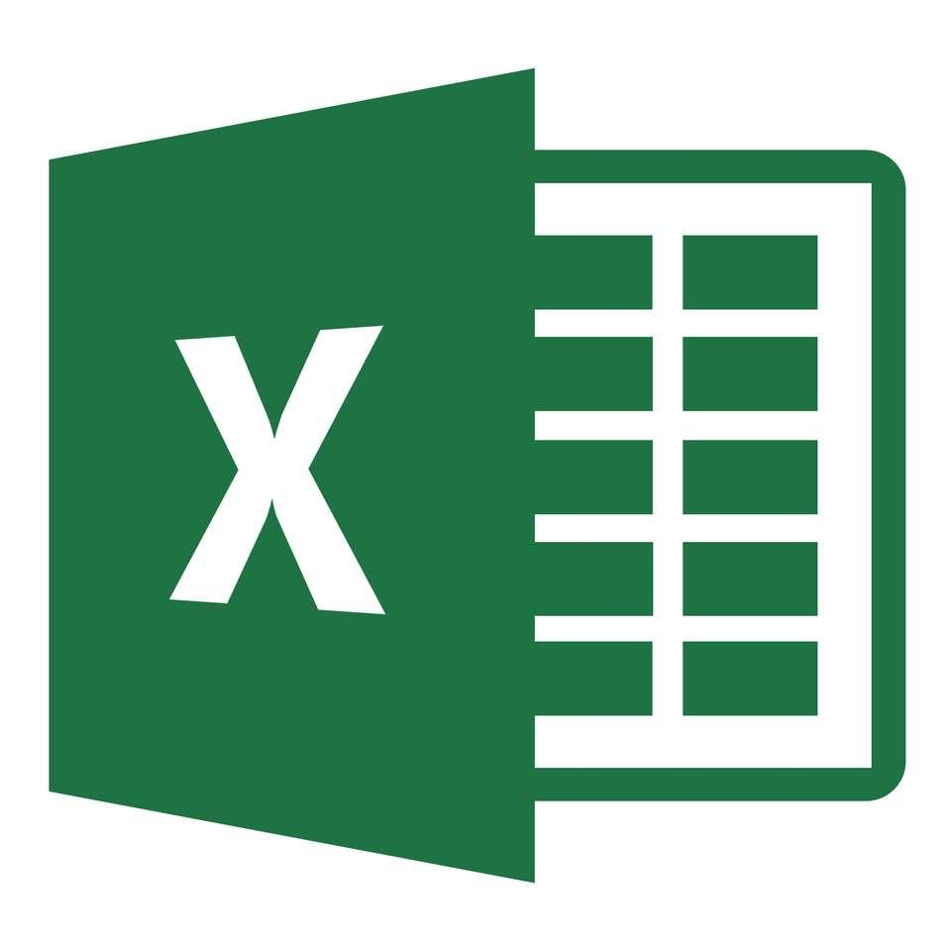

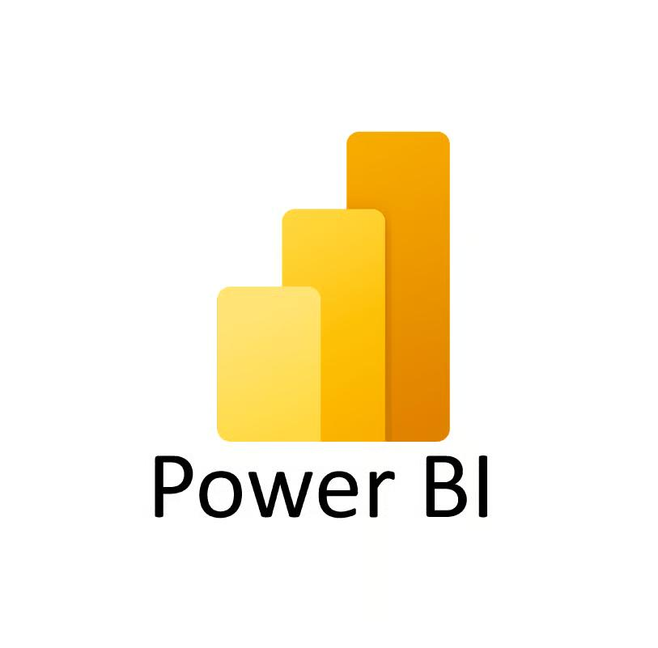
Tools and Technologies Used
Microsoft Excel
Used to inspect, clean, and prepare the datasets before analysis.
Power Query
Used to transform data and handle data quality issues.
PostgreSQL
Created the database and imported the Orders and Order Items tables.
Power BI
Built the data model, created DAX measures, and developed the four-page interactive report.

Slide 5
Dataset Preparation and Data Cleaning
Worked with five datasets: Customers, Employees, Products, Orders, and Order Items.
Removed confirmed duplicate records.
Standardized names, cities, regions, and email formats.
Handled missing values using available information where possible.
Corrected identified data inconsistencies, including a date and product details.
Retained unknown or uncertain values instead of making assumptions.
Outcome: Prepared the datasets for database integration and Power BI analysis.

Slide 6
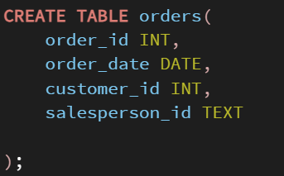
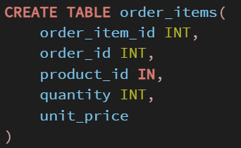
PostgreSQL Database Integration
Created a PostgreSQL database named sales_db.
Created the orders and order_items tables.
Imported the corresponding CSV files into PostgreSQL.
Connected the sales data with Power BI for reporting and analysis.
Verified the imported tables and their data.
Outcome: Successfully integrated the sales tables into the database workflow.

Slide 7
Data Modelling and Relationships
Created relationships between Customers, Orders, Order Items, Products, and Employees.
Created a Calendar table using DAX for date-based analysis.
Calendar = CALENDAR(MIN('Orders Data'[order_date]),MAX('Orders Data'[order_date]))
Connected the Calendar table to Orders using the order date.
Organized the tables into fact and dimension tables.
Set up the data model to support interactive filtering and reporting.
Outcome: Built a connected data model for analysing sales from different perspectives.

Slide 8
DAX Measures and Calculations
Created DAX measures to calculate Total Revenue, Order Count, and Total Quantity.
Calculated Revenue Per Order and Average Order Revenue.
Created measures for regional and high-value revenue analysis.
Added time-based calculations such as YTD Revenue and Previous Month Revenue.
Created Year-over-Year Growth measures for time comparison.
Outcome: Developed reusable calculations to analyse sales performance and support business decisions.

Slide 9
Total Revenue = SUM('Order_items Data'[revenue])
Order Count = COUNT('Orders Data'[order_id]) or COUNTROWS('Orders Data')
Average Order Revenue = AVERAGE('Order_items Data'[revenue])
Total Quantity = SUM('Order_items Data'[quantity])
Revenue Per Order = DIVIDE([Total Revenue],[Order Count])
South Revenue = CALCULATE([Total Revenue],Customers_Data[Region]="South")
High Value Revenue = CALCULATE([Total Revenue],FILTER('Order_items Data','Order_items Data'[revenue]>3000))
Company Revenue = CALCULATE([Total Revenue],ALL(Customers_Data[Region]))
YTD Revenue = TOTALYTD([Total Revenue],'Calendar'[Date])
Previous Month Revenue = CALCULATE([Total Revenue],DATEADD('Calendar'[Date],-1,MONTH))
Sales LY = CALCULATE([Total Revenue],SAMEPERIODLASTYEAR('Calendar'[Date]))
YOY Growth % = DIVIDE([Total Revenue]-[Sales LY],[Sales LY])
  Year = YEAR('Calendar'[Date])
  Month Number = MONTH('Calendar'[Date])
  Month Name = FORMAT('Calendar'[Date],"MMMM")
  Quarter = "Qtr" & FORMAT('Calendar'[Date],"Q")
  Day = DAY('Calendar'[Date])

Slide 10
Executive Overview Dashboard
Created the first report page to provide a summary of sales performance.
Added KPI cards for Total Revenue, Order Count, Total Quantity, and Revenue Per Order.
Used a line chart to analyse monthly revenue.
Used a chart to compare revenue across regions.
Added Region and Month slicers for interactive filtering.
Added navigation buttons to help users move between report pages.
Outcome: Created an interactive overview with key sales metrics, charts, slicers, and navigation buttons..

Slide 11
Sales Performance Dashboard
Created a report page to analyse salesperson and regional performance.
Added a bar chart to compare salesperson revenue.
Used a funnel chart to analyse revenue by region.
Added a line chart to view sales trends.
Included Month, Region, and Salesperson slicers.
Added a customer table and drill-through for detailed analysis.
Outcome: Developed an interactive page to compare sales performance across employees and regions.

Slide 12
Product Analysis Dashboard
Created a report page to analyse product sales.
Used a bar chart to compare revenue by product.
Added a column chart to compare revenue by category.
Included a treemap to visualize revenue distribution.
Added Product and Category slicers for interactive analysis.
Outcome: Identified product and category revenue patterns to support sales and inventory decisions.

Slide 13
Customer Details Dashboard
Created a report page to analyse customer-wise sales performance.
Added a table showing customer details, order count, revenue, and quantity.
Used a bar chart to compare revenue by customer.
Added a donut chart to show revenue distribution by region.
Included Region and Customer slicers.
Enabled drill-through for detailed customer analysis.
Outcome: Developed a customer-focused report to understand purchasing patterns and compare customer contributions to revenue.

Slide 14
Interactivity and Security
Interactive Features
Added slicers to filter report data.
Implemented bookmarks for Sales Overview and Detailed Analysis.
Added page navigation buttons and a Reset Filters button.
Enabled drill-down and drill-through for detailed analysis.
Row-Level Security (RLS)
Created a role named North Manager.
Applied a filter to display only North region customer data.
Tested the role using the View As feature in Power BI.
Outcome: Improved report navigation and demonstrated region-based data access control.

Slide 15
Results and Management Summary
Total Revenue: 3.96M
Total Orders: 399
Total Quantity Sold: 2,058 units
South region generated the highest revenue.
Electronics was the top-performing category.
Air Purifier Mini was the top-performing product.
Revenue showed fluctuations across months, with stronger performance around Q2.

Slide 16
Recommendations
Focus on high-performing products and categories.
Maintain sufficient stock for products with strong demand.
Identify opportunities to improve sales in lower-performing regions.
Monitor monthly sales trends to support planning.
Outcome: Summarized key sales insights and identified opportunities to improve business performance.

Slide 17
Conclusion & Future Scope
Completed an interactive, four-page Power BI sales analysis report.
Cleaned and prepared five datasets for analysis.
Integrated PostgreSQL tables into the reporting workflow.
Created relationships, DAX measures, and interactive visualizations.
Tested Row-Level Security for the North region.
Future Scope
Add more years of sales data for year-over-year comparisons.
Publish the report to Power BI Service when an appropriate account is available.
Outcome: Gained practical experience in data cleaning, database integration, data modelling, DAX, dashboard development, and data security.

Slide 18


